Slide 1

Texas Airbnb
Online Marketplace For Homestays Service
Nguyen Binh Nam

Slide 2
Table of Contents
Quick Overview of Dataset
Question/Audience/Metrics
Price vs Quality
Location vs Quality
Price vs Time
Discussion/Conclusion

Slide 3
Quick overview
9,592
25 - 10000 $
100
Different Airbnbs
Price Range
Different Neighbourhoods

Slide 4
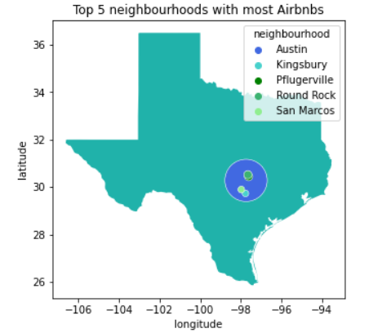
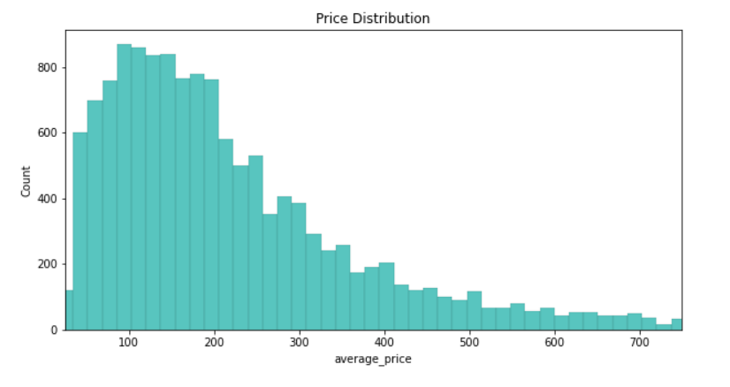
Quick overview
Question: How do customers find cost-efficient airbnbs? What are the factors?

Slide 5
What metrics defines quality?
Rating scores and reviews per months
 | review_scores_rating | reviews_per_month
mean | 4.806752 | 1.6733
min | 0 | 0.01
25% | 4.76 | 0.3775
50% | 4.92 | 1.1
75% | 5 | 2.39
max | 5 | 35.18

Slide 6
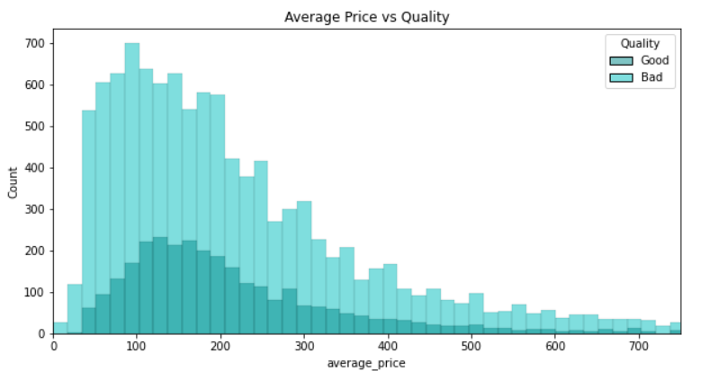
Higher Price, Better Quality?
There are a lot of bad qualities compared to good. Apart from that, the ratio of Good over Bad seems random as price increases.

Slide 7
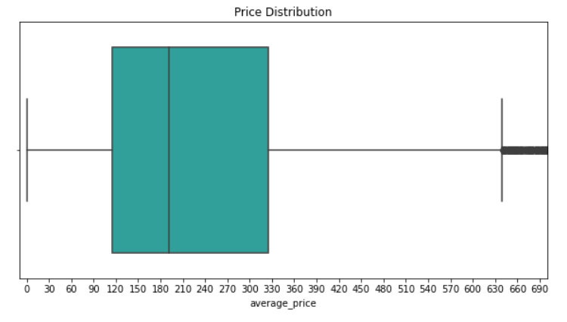
Classification and Standard Deviation
Four Category: Very Cheap, Cheap, Affordable, Expensive based on quartile percentage

Slide 8
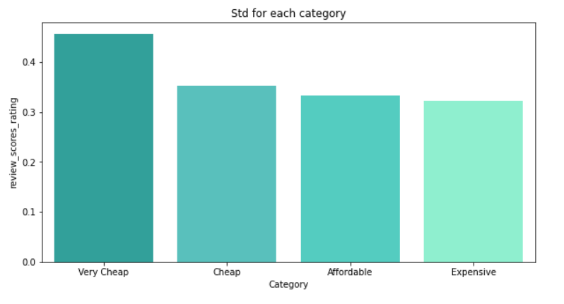
Classification and Standard Deviation
Standard Deviation values decreases from the very cheap group to the expensive group.

Slide 9
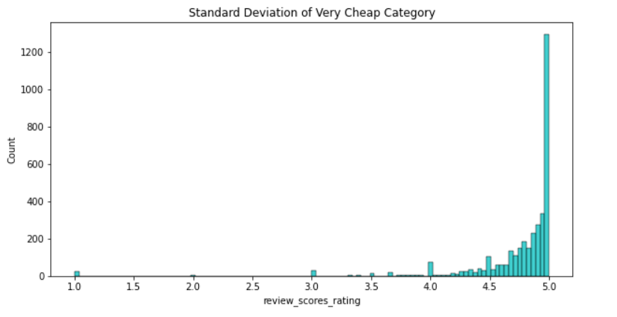
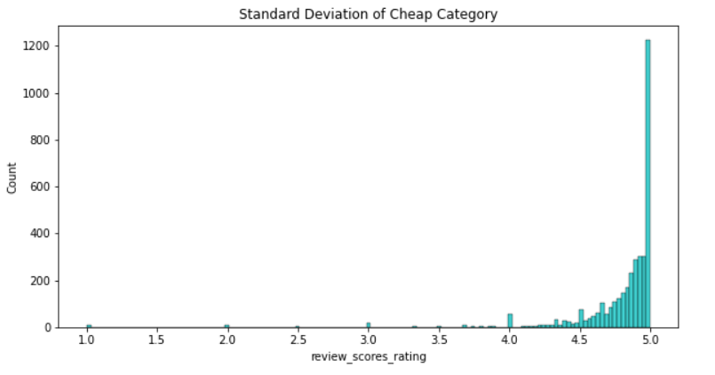
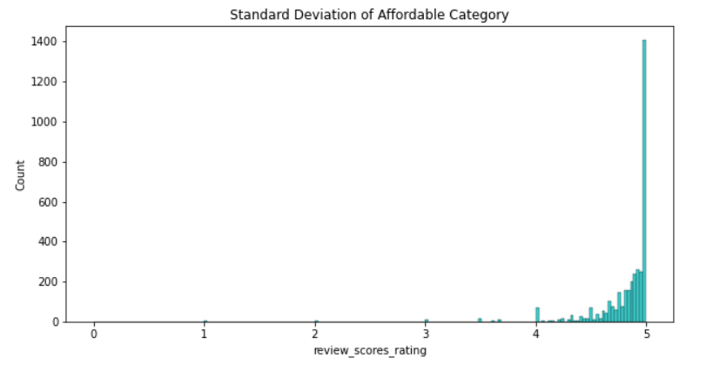
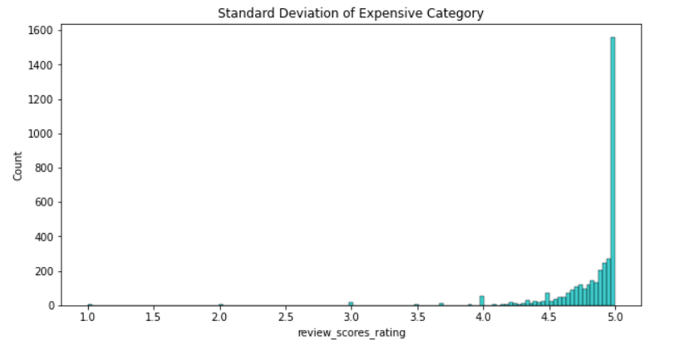

Slide 10
Location vs Quality
1
Does the more airbnbs in a neighbourhood means better quality? How does location affect quality?

Slide 11
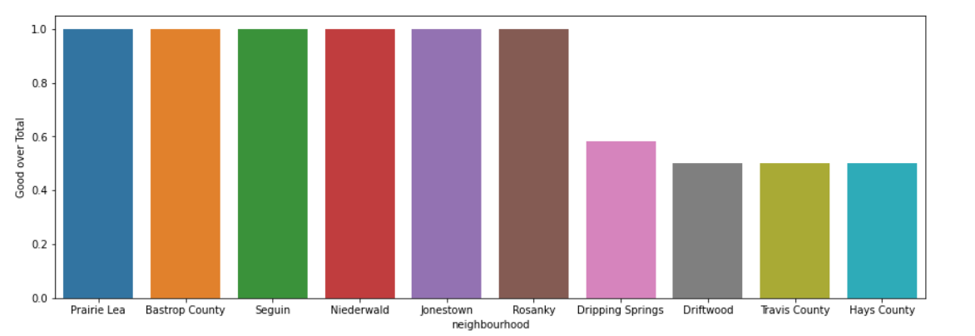
What are the metrics? Good over Total ratio per neighbourhood
Grouping Airbnbs based on their neighbourhoods
Finding the ratio of good airbnbs over the total number of airbnbs in each neighbourhood

Slide 12
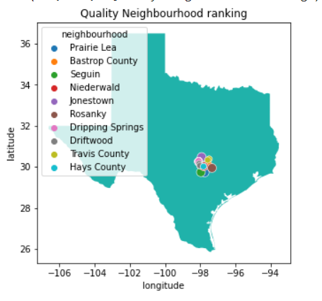
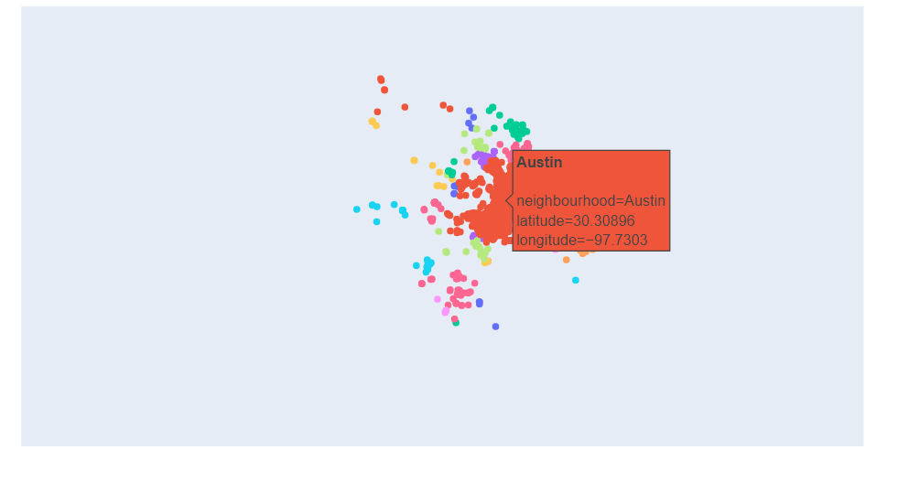
Visualization
Conclusion: Places like Rosanky and Seguin, even though they're not major cities, have only a few but good quality airbnbs. Another thing is that most of these cities are located in the suburban of Austin.

Slide 13
Time vs Price
2
Does holiday affect prices ? When does price increase/decreases?

Slide 14
What is the metric?
Finding the ratio of good airbnbs over the total number of airbnbs in each neighbourhood
listing_id | date | Ratio
304808 | 2022-09-13 | 0.887669
304808 | 2022-09-14 | 0.887669
304808 | 2022-09-15 | 0.887669
304808 | 2022-09-16 | 1.187558
304808 | 2022-09-17 | 1.187558
listing_id | date | Ratio
40750053 | 2022-09-13 | 0.900968
40750053 | 2022-09-14 | 0.900968
40750053 | 2022-09-15 | 1.261355
40750053 | 2022-09-16 | 1.681806
40750053 | 2022-09-17 | 1.681806

Slide 15
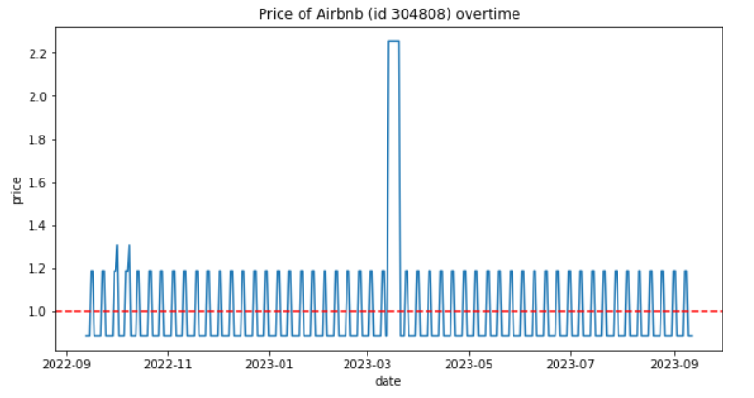
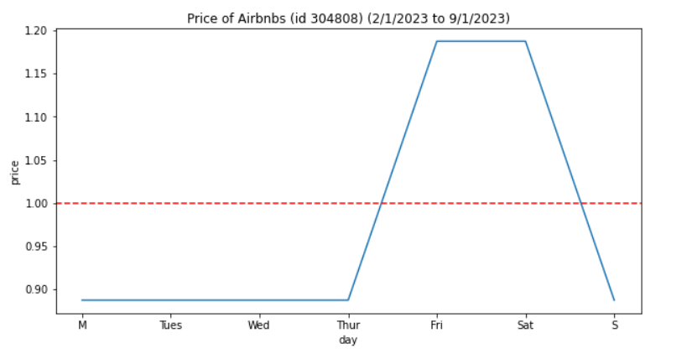
Visualization

Slide 16

Ratio increases
Conclusion: weekdays are cheaper than weekends.
 | Ratio Price of each over Mean Price
Day | Monday | Tuesday | Wednesday | Thursday | Friday | Saturday | Sunday
304808 | 0.85 | 0.85 | 0.85 | 0.85 | 1.2 | 1.2 | 0.85
883802 | 0.85 | 0.85 | 0.85 | 0.85 | 1.2 | 1.2 | 0.85
50767556 | 0.7 | 0.74 | 0.74 | 0.74 | 1.15 | 1.2 | 0.7
40750053 | 1 | 1.03 | 1 | 1.12 | 1.35 | 1.25 | 1.1

Slide 17
Conclusion
Higher price doesn’t mean better quality. However, there is a higher chance of getting 5 score rating at high price compared to lower price.
Places like Rosanky and Seguin, even though they're not major cities, have only a few but good quality airbnbs. Another thing is that most of these cities are located to the south of Austin.
Weekdays are cheaper than weekends. Prices starts to increase gradually from Thursday to Friday and gradually decreases from Saturday to Sunday

